Slide 1
https://github.com/eunomia-bpf/bpf-developer-tutorial/blob/735095982d9d0347b3482510ab3babe604e33cdd/src/29-sockops/README_en.md
This link will help to understand ebpf in a better way.

Slide 2
https://fossd.anu.edu.au/linux/latest/source/samples/bpf/tcp_iw_kern.c
After i read this code and its documentation where all its variables are defined and explained .I made my own code
https://github.com/bhavya2021245/tcp_ebpf_/tree/main
In this repository it contains the code and also its explanation.

Slide 3
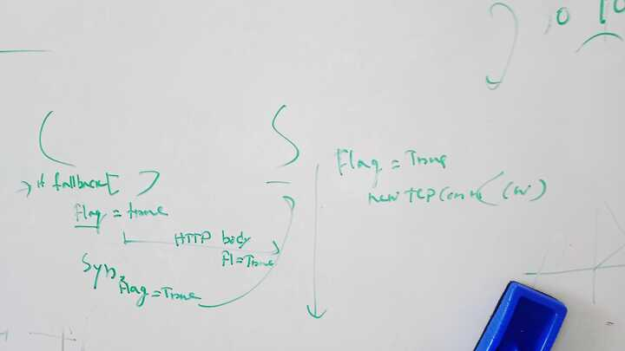
M
MEETING

Slide 4
HTTP HEADERS
My working

Slide 5
HEADER FIELDS
1.Each header field comprises a key-value pair, with a colon ":" separating the field name (key) from the field value (value).
https://www.iproyal.net/en-us/blog/what-is-http-header
2.Header fields defined in chromium request header file
https://docs.google.com/document/d/1KuvuHbYNRf-oZ9Zoxjc_zKo038c42eHWsrLO5Kwjgrs/edit?usp=sharing

Slide 6
TASKS
ADDING A NEW HEADER FIELD
SETTING TRUE OR FALSE DEPENDING ON NETWORK CONDITIONS AND ERRORS
TESTING IT ON CLIENT SERVER

Slide 7
TASK1
Read how to add a new header field and then Defined in http_request_headers.h file and http_request_headers.cc with key as Fallback

Slide 8
TASK2
Meeting with Sapna di where we discussed about network quality estimator and errors on which i worked and found out this.
https://docs.google.com/presentation/d/1kv1NmlI-xtGp9emMF5qLB4iGoIUioSeZdAYm9S704Fw/edit?usp=sharing

Slide 9
Read this pdf which explained about the network quality estimation in chrome and made the notes
https://www.w3.org/2020/02/05-web-networks-Network-Quality-Estimation-in-Chrome.pdf
Read this paper’s portion IV. EXPLORING BROWSER’S IMPLEMENTATION chromium Implementation and made the notes
https://ieeexplore.ieee.org/stamp/stamp.jsp?tp=&arnumber=10453353

Slide 10
Read the error code file and found these errors which happens due to poor network conditions
https://docs.google.com/document/d/17i9B5pxlZCXrampeM46vRFpyK1HZup17bPJ_A5zU50I/edit?usp=sharing
https://source.chromium.org/chromium/chromium/src/+/HEAD:net/third_party/quiche/src/quiche/quic/core/quic_error_codes.h
Read the network quality estimator code
https://source.chromium.org/chromium/chromium/src/+/HEAD:net/third_party/quiche/src/quiche/quic/core/quic_error_codes.h

Slide 11
Read the 8b portion of this paper.
https://ieeexplore.ieee.org/document/10453353
If the RTT is varying, there will be fewer QUIC retry connection establishment failures which will lead to low medium connection racing(here this means fallback). Otherwise, if QUIC RTT is more than a threshold δ ms, then there will be more QUIC connection establishment retry failures and lead to more connection racing.

Slide 12
FLOW CONTROL IN QUIC
https://docs.google.com/document/d/1F2YfdDXKpy20WVKJueEf4abn_LVZHhMUMS5gX6Pgjl4/mobilebasic#:~:text=In%20QUIC%2C%20flow%20control%20works%20by%20advertising%20the,may%20only%20write%20another%2050%20bytes%20before%20blocking.
Minimum Flow Control Send Window:
This value (16 KB) represents the smallest amount of data that can be sent without waiting for an acknowledgment from the receiver.

Slide 13
Maximum Flow Control Receive Windows:
These values define the upper limits on how much data the receiver is willing to accept before acknowledging receipt and freeing up space for more data.
Stream Receive Window Limit (kStreamReceiveWindowLimit): This limit (16 MB) applies to individual data streams within the QUIC connection. It ensures that a single stream does not overwhelm the receiver by sending too much data too quickly.
Session Receive Window Limit (kSessionReceiveWindowLimit): This limit (24 MB) applies to the entire session, encompassing all streams. It sets an overall cap on the amount of unacknowledged data that can exist within the connection.

Slide 14
Imagine a QUIC connection where the sender has a CFCW of 15 MB and an SFCW of 6 MB (Chromium's values). This means the sender can send up to 15 MB of data at the connection level and up to 6 MB of data per stream before waiting for acknowledgments.
Flow Control Windows:
CFCW (Connection Flow Control Window): Chromium sets this to 15 MB (15728640 bytes), which means that, at the connection level, it can send up to 15 MB of data before waiting for acknowledgments.
SFCW (Stream Flow Control Window): Chromium sets this to 6 MB (6291456 bytes), limiting the amount of unacknowledged data per stream to 6 MB.

Slide 15
DISABLED AUTO TUNING
QUIC can not dynamically adjust the flow control window size based on network conditions, optimizing data transmission
Auto-tuning aims to optimize the receive window size in QUIC, starting with a small initial window and dynamically growing it as needed.
Algorithm:
Flow Control Window Update Trigger:
A flow control window update is triggered when the available window (max receive window offset minus bytes consumed) is less than half of the maximum window size.
Auto-Tuning Logic:
Keep track of the time interval between subsequent window updates (since_last_update).
If (since_last_update < RTT * trigger factor), then increase the maximum window size by a factor (increase factor), but not exceeding an upper bound.
The condition max window size = MIN(max window size * increase factor, upper bound) ensures that the window size increase is capped at a reasonable limit defined by the upper bound.
The trigger factor is set to 2, and the increase factor is also set to 2.
Window Update Action:
When a window update occurs, the max_received window offset is increased by the difference between the maximum window size and the available window.
Default Values:
Google's servers default to enabling auto-tuning for receive buffers with initial window size settings of CFCW (Connection Flow Control Window) at 48 KB and SFCW (Stream Flow Control Window) at 32 KB.
Chromium, on the other hand, defaults to disabling auto-tuning for its receive buffers, meaning it does not dynamically adjust the receive window size based on the algorithm described above.

Slide 16
VERY IMPORTANT
https://codereview.chromium.org/2745253006/
This contains the files in which we need to make changes so as to make auto tuning faster.
In QUIC (Quick UDP Internet Connections), flow control is essential for managing data transmission between endpoints efficiently. Autotuning the flow control to increase the window size promptly for the first increase, similar to subsequent increases, can enhance performance.
prev_window_update_time_ refers to a variable or mechanism that tracks the time of the last window update.

Slide 17
https://source.chromium.org/chromium/chromium/src/+/main:net/third_party/quiche/src/quiche/quic/core/quic_flow_controller.cc
FLOW CONTROLLER
automatically increases the window size if half of the window is used within less than two Round-Trip Times (RTTs)
As it imply that the sender could transmit more data without causing congestion

Slide 18
https://source.chromium.org/chromium/chromium/src/+/main:net/third_party/quiche/src/quiche/quic/core/quic_flags_list.h;l=7;drc=aac75e1d42c143ae268bd6adfdec9191f2cc1c33?q=quic_fla&sq=&ss=chromium%2Fchromium%2Fsrc
QUIC FLAG LIST
Allow QUIC's flow control autotuning to increase the window as quickly for the first adjustment as in subsequent ones.
FLAGS_quic_reloadable_flag_quic_flow_control_faster_autotune

Slide 19
https://source.chromium.org/chromium/chromium/src/+/main:net/third_party/quiche/src/quiche/quic/core/quic_session.cc
QUIC SESSSION

Slide 20
OFFICIAL QUIC PAPER(READ FLOW CONTROL)
https://dl.acm.org/doi/pdf/10.1145/3098822.3098842

Slide 21
IDEA 1 -I GOT FROM THIS BELOW LINK
https://source.chromium.org/chromium/chromium/src/+/main:net/quic/quic_session_pool_test.cc;l=7159?q=QUIC_NETWORK_IDLE_TIMEOUT&ss=chromium%2Fchromium%2Fsrc
Changes i made in http network transaction.cc in BuildRequestHeaders function
quic::QuicErrorCode quic_error
Adding this as a parameter

Slide 22
#include "quiche/quic/core/quic_error_codes.h"
#include "net/nqe/network_quality.h"
Adding these as header files
if (quic_error == quic::QUIC_NETWORK_IDLE_TIMEOUT) {
request_headers_.SetHeader(HttpRequestHeaders::kFallback,
"True");
} else {
request_headers_.SetHeader(HttpRequestHeaders::kFallback, "False");
}
My if-else statement

Slide 23
But when function is called in network transaction file only i have to pass parameter a error code which will create a problem as rather than testing whether my header is set based on that error or not it will just basically make that error to occur frequently and will always the fallback header to true.
Hence this idea was dropped

Slide 24
IDEA 2- got from this file
https://source.chromium.org/chromium/chromium/src/+/main:net/quic/quic_chromium_client_session.cc;l=1763
So now i am passing a frame as parameter and checking if that frame error code has that particular error code.
In the below file the complete structure of frame is mentioned
https://source.chromium.org/chromium/chromium/src/+/main:net/third_party/quiche/src/quiche/quic/core/frames/quic_connection_close_frame.h;drc=ffa073e3fa09b2be387adb32663a3ca9e93e61e9;l=18

Slide 25
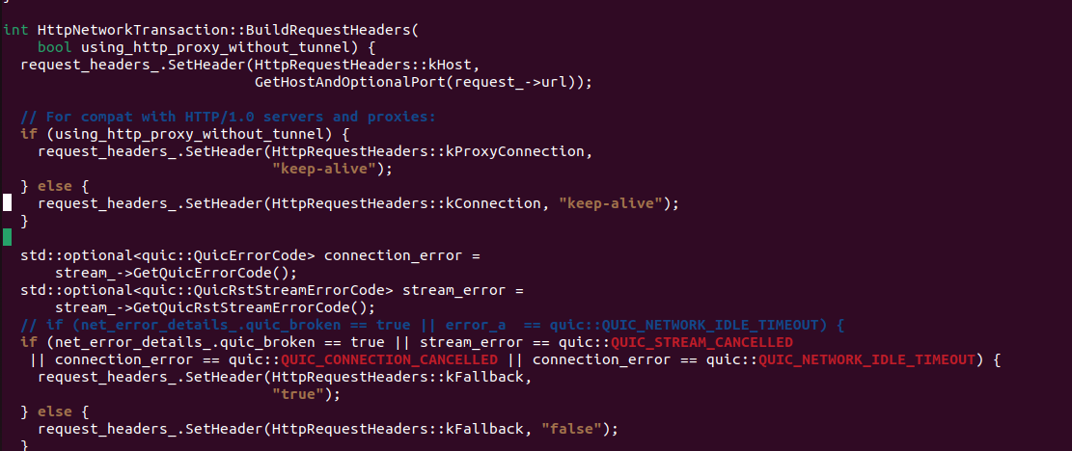
FINAL CHANGES(I made in this code)

Slide 26
CHANGES
Changes are made in http_network_transaction.cc in the BuildRequestHeaders function.

